Slide 1
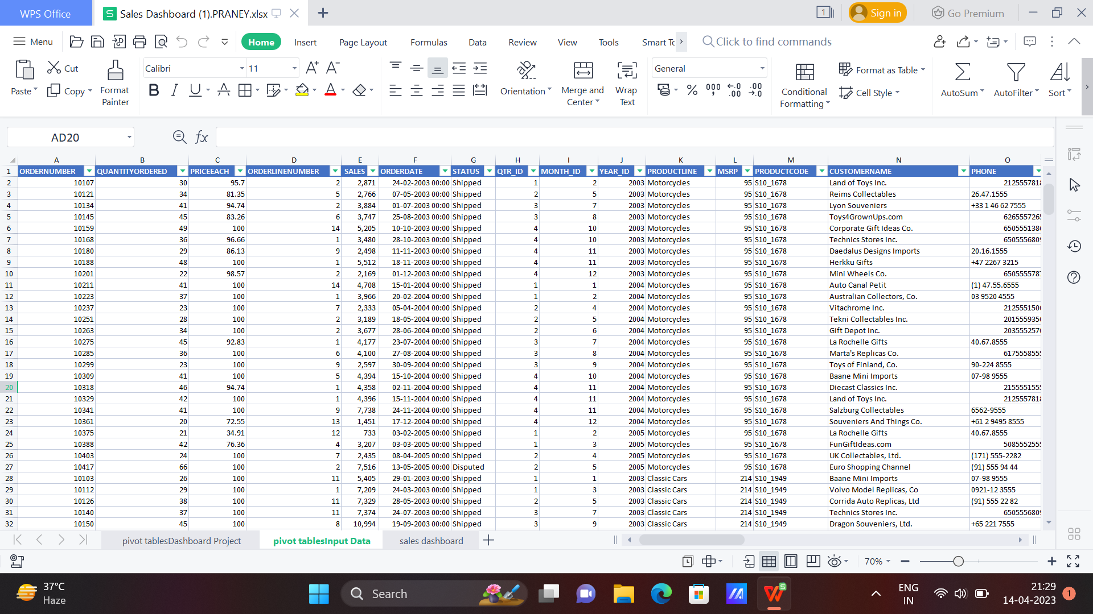

Slide 9
TOP SELLING PRODUCT
CLASSIC CARS
REGION WITH HIGHEST SALES
NORTH AMERICA
COUNTRY WITH HIGHEST REVENUE
USA

Slide 10
THANK YOU

